Slide 1

Ethernet & Bluetooth
School of Computer Science Engineering and Technology Bennett University
Greater Noida – 201310

Slide 2
Ethernet
Bluetooth
Outline

Slide 3
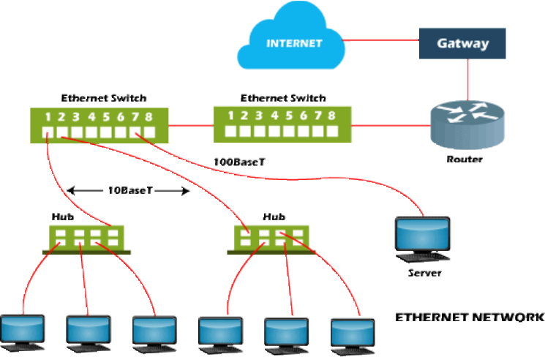
Ethernet : Definition
Ethernet is a type of communication technology that is created at Xerox PARC in 1973 by Robert Metcalfe.
Ethernet is used to connect several computers to make a
LAN.
It is a widely used LAN protocol that connects computers within the LAN and WAN.
A simple user interface to connect various devices easily.
Devices can be connected using Ethernet port.
The wireless networks replaced Ethernet in many areas; however, Ethernet is still more common for wired networking.
Wired connections are more secure and are less prone to interference.

Slide 4
It is used by specific organizations for local networks, organizations such as school campuses and hospitals, company offices, etc. for its high speed, security, and reliability.
Ethernet : Features
Ethernet is of low price.
Ethernet delivers higher levels of performance with maintaining backward compatibility.

Slide 5
Ethernet : Types
Fast Ethernet: Supported by a twisted pair or CAT5 cable, can transfer or receive data at around 100 Mbps. The 100BASE-TX, 100BASE-FX, and 100BASE-T4 are the three categories of Fast Ethernet.
Gigabit Ethernet: It uses fiber optic cable and twisted pair cable to create communication and it can
transfer data at a rate of 1000 Mbps or 1Gbps.
10-Gigabit Ethernet: The network can transmit data at a rate of 10 Gigabit/second, uses CAT6a or CAT7 twisted-pair cables and fiber optic cables as well. This network can be expended up to nearly 10,000 meters with the help of using a fiber optic cable.
Switch Ethernet:
The network involves adding switches or hubs, which helps to improve network throughput as each workstation can have its own dedicated 10 Mbps connection instead of sharing the medium.
Instead of using a crossover cable, a regular network cable is used when a switch is used in a network.
The main task of the switch in a network is to transfer the data from one device to another device in the same network without affecting the other devices.
It supports 1000Mbps to 10 Gbps for latest Ethernet and 10Mbps to 100Mbps for fast Ethernet. This type of Ethernet makes use of star topology.

Slide 6
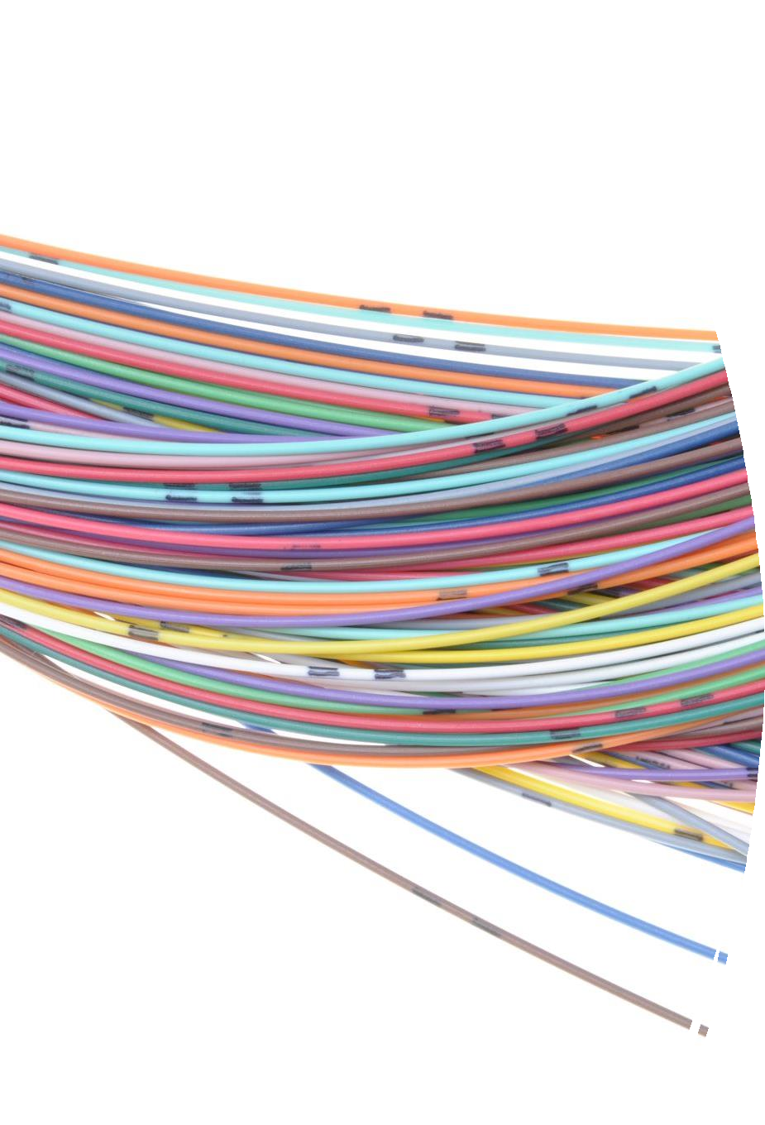
Ethernet : Types II
Various Types of Ethernet Cables
10Base2: This is a thin twisted pair coaxial cable.
10Base5: This is thick twisted pair coaxial cables.
10Base T: This is a twisted pair cable which offers a speed of around 10 Mbps.
100BaseTX: This is a twisted pair cable and offer a speed of
100 Mbps.
100Base FX: Fiber optic protocol which offers a speed of 100 Mbps.
1000Base SX: Fiber optic protocol which utilizes a wavelength
of 850nm for multimode networks.
1000Base LX: Fiber optic protocol which utilizes a wavelength
of 1310 nm, for multimode networks and up to 1550nm for singlemode networks.

Slide 7



Ethernet : Advantage & Disadvantage
Advantage
Disadvantage
It needs deterministic service; therefore, it is not considered the best for real-time applications.
Restricts in terms of distances.
If you create a wired ethernet network that needs
cables, hubs, switches, routers, they increase the cost of installation.
Data needs quick transfer in an interactive
application.
Acknowledge is not sent by receiver after accepting a packet.
It is not easy to determine which node or cable is
causing the problem.
It is relatively inexpensive.
It provides high security for data as it uses firewalls in
terms of data security.
It can transmit data at a speed of 1-100Gbps.
The quality of the data transfer does maintain.
Administration and maintenance are easier.

Slide 8
Bluetooth
It is a cable replacement technology
When two Bluetooth devices come within 50m range of each other, they establish connection together
Uses radio waves for communication
Ability to communicate with many different devices at once without interference
Open standard for short-range transmission of digital voice and data that supports point-to-point and
multipoint applications
Operates
in the unlicensed ISM band at 2.4 GHz which is available globally, along slight variation of
location and width of band apply
Frequency Hopping scheme (1600 hops/sec)
1 Mb/s symbol rate
Range 10+ meters

Slide 9
Bluetooth (Cont…)
Bluetooth supports
Synchronous & asynchronous data channels.
Three simultaneous synchronous voice channels, or
One channel, with asynchronous data and synchronous voice
Each voice channel supports 64 kb/s in each direction.
The channel can support maximal 723.2 kb/s asymmetric (and still up to 57.6 kb/s in the return direction), or 433.9 kb/s symmetric.
Bluetooth provides
point-to-point connection (only two Bluetooth units involved), or
point-to-multipoint connection.
Support both packet-switching and circuit-switching

Slide 10
Bluetooth (Cont…)
Bluetooth Special Interest Group (SIG) founded in Spring 1998 by Ericsson, Intel, IBM, Nokia, Toshiba;
Now more than 2000 organizations joint the SIG
Key features:
Robustness
low complexity
low power consumption, which enables maximum performance longevity for battery powered devices
low cost
Limitations:
Security
Interference with wireless LANs

Slide 11
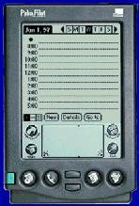
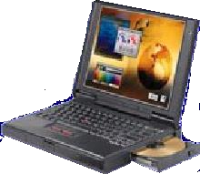
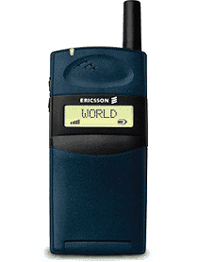
Application: Synchronization
Data Access Points
Synchronization
Headset
Conference Table
Cordless Computer
Business Card Exchange
Instant Postcard
Computer Speakerphone

Slide 12
Bluetooth Topology
Bluetooth-enabled devices can automatically locate each other
Topology is established on a temporary and random basis
Up to eight Bluetooth devices may be networked together in a master-slave relationship to form a Piconet
Piconet is an ad-hoc computer network of devices using Bluetooth technology protocols to allow one master
device to interconnect with up to seven active slave devices
Adhoc network:
is a network connection method which is most often associated with wireless devices.
The connection is established for the duration of one session and requires no base station.
Instead, devices discover others within range to form a network for those computers.
Devices may search for target nodes that are out of range by flooding the network with broadcasts that are forwarded by each node.
Connections are possible over multiple nodes (multihop ad hoc network).
Routing protocols then provide stable connections even if nodes are moving around

Slide 13
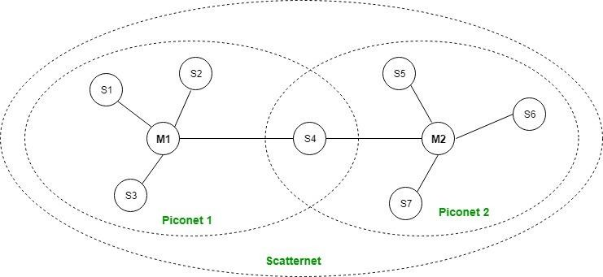
Bluetooth Topology (Cont …)
One is master, which controls and setup the
network
All devices operate on the same channel and follow the same frequency hopping sequence
Two or more piconet interconnected to form a scatter net
Only one master for each piconet
A device can’t be masters for two piconets
The slave of one piconet can be the master of another piconet

Slide 14
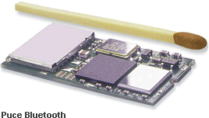

Bluetooth Working
Bluetooth is a standard for tiny, radio frequency
chips that can be plugged into your devices
These chips were designed to take all of the information that your wires normally send, and transmit it at a special frequency to something called a receiver Bluetooth chip
The information is then transmitted to your device
Bluetooth Chip
RF
Baseband
Controller
Link
Manager

Slide 15
IEEE Standards
Institute of Electrical and Electronics Engineers (IEEE) is an organization composed of engineers, scientists, and students which develops standards for the computer and electronics industry.
Various standards are-
IEEE 802
IEEE 802.1
IEEE 802.1x
IEEE 802.2
IEEE 802.3
IEEE 802.3ae
IEEE 802.8
IEEE 802.11
IEEE 802.15
LAN/MAN Overview and architecture LAN/MAN Bridging and management Port-based network access control Logical Link Control (LLC)
Ethernet
10 Gigabit Ethernet
Fiber Optic Wi-Fi
Wireless Personal Area Network (WPAN) e.g., bluetooth

Slide 16
References
https://www.elprocus.com/what-is-ethernet-and-different-types-of-ethernet-networks/
https://ecomputernotes.com/computernetworkingnotes/communication-networks/ethernet
https://www.javatpoint.com/what-is-ethernet
https://www.youtube.com/watch?v=jzxZUJmOu3o&t=525s
https://www.youtube.com/watch?v=ixY0Cau4mBM
https://www.youtube.com/watch?v=t3FVP5wuG4g
https://www.netspotapp.com/blog/wifi-security/wifi-encryption-and- security.html#:~:text=WiFi%20routers%20support%20a%20variety,needs%20to%20protect%20your%20netw ork.

